Slide 1

stormtrooper_java Database Schema
IS664 Database Programming Spring 2021
Demonstration Database
Professor HG Locklear

Slide 2
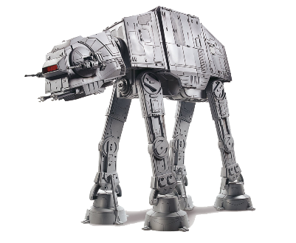
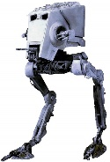

General
The stormtrooper_java database is one of our demonstration databases for the semester.
Some Class Exercises and Homework will utilize this database.
The database consists of 11 tables which represent the structure of an Imperial Stormtrooper Brigade (structure below)
Imperial Brigade
Battle Group
I
Battle Group
II

Slide 3
stormtrooper_java Schema
imperial_battlegroup
PK BGID
HAS
stormtrooper_unit
PK STUID FK1 UnitCmd( imperial_battlegroup (BGID))
1
M
1
st_officer_assign
PK STID FK1 STID( stormtroopers_officer(STID)) FK2 STUID( stormtrooper_unit(STUID))
st_nco_assign
PK STID FK1 STID( stormtroopers_nco(STID)) FK2 STUID( stormtrooper_unit(STUID))
st_troop_assign
PK STID FK1 STID( stormtroopers_troop(STID)) FK2 STUID( stormtrooper_unit(STUID)
1
HAVE
1
HAVE
1
1
HAVE
1
1
stormtroopers_officer
PK STID
stormtroopers_nco
PK STID
stormtroopers_troop
PK STID

Slide 4
stormtrooper_java Schema
imperial_battlegroup
PK BGID
HAS
walker_units
PK WUID FK1 BattleGroup( imperial_battlegroup (BGID))
1
M
HAS
imperial_walkers_assign
PK WID FK1 WUID(walker_units(WUID)) FK2 WalkerType( imperial_walkers( WType))
M
1
1
ARE
1
imperial_walker_type
PK WTypeID UK WType

Slide 5
stormtrooper_java Schema
imperial_battlegroup
BGID | Designation | HQ_LocationX | HQ_LocationY
stormtrooper_unit
STUID | UnitCmd | UnitType | AssignedStrength | Location_X | Location_Y
stormtroopers_officer
stormtroopers_nco
stormtroopers_troop
STID | Rank | Gender | ServiceYears | Height | Weight | DutyCategory | DutyStatus
st_officer_assign
st_nco_assign
st_troop_assign
STID | STUID | Role

Slide 6
stormtrooper_java Schema
imperial_walker_type
WTypeID | WType | Height | Length | Width | Weight | Crew | TroopCapacity | MaximumSpeed | OpRange
walker_units
WUID | BattleGroup | Location_X | Location_Y
imperial_walkers_assign
WID | WUID | WalkerType | Status

Slide 7
stormtrooper_java Schema
Relation | Description
imperial_battlegroup | Imperial Battle Groups represent the Higher HQ for Stormtrooper Units
stormtrooper_unit | Stormtrooper Units contain stormtroopers of various ranks and capabilities
stormtroopers_officer | Stormtrooper Officers perform leadership jobs within Stormtrooper Units and generally command smaller detachments of stormtroopers
stormtroopers_nco | Stormtrooper NCOs perform low-leadership jobs within Stormtrooper Units and assist officers
stormtroopers_troop | Rank and file Stormtroopers
st_officer_assign | Unit to which a stormtrooper officer is assigned
st_nco_assign | Unit to which a stormtrooper NCO is assigned
st_troop_assign | Unit to which a stormtrooper is assigned
imperial_walker_type | Specifications of the Imperial Walkers that are available to Imperial Battle Groups
walker_units | Walker Units contain Imperial Walkers
imperial_walkers_assign | Units to which Imperial Walkers are assigned

